Slide 1

Project Presentation
PLANT LEAF DISEASE DETECTION AND CLASSIFICATION
SESSION : 2024-25 (ODD SEMESTER)
Mentor: Ms. Rati Goyal
Group Members:
Shikhar Sharma (2100301540071)
Piyush Pandey (2100301540052)
Ujjwal Singh (2100301540079)
Yash Srivastava (2100301540087)

Slide 2
Objective
This project seeks to address these challenges by developing an AI-powered system for plant leaf disease detection and classification using computer vision techniques. The goal is to create a scalable, efficient, and user-friendly solution that can analyze leaf images, identify diseases with high accuracy, and provide actionable recommendations to farmers and agricultural stakeholders

Slide 3
Literature Review
 | Authors | Dataset | Feature Extraction | Classifier | Accuracy (%)
Rice | Joshi & Jadhav 2017 [28] Zhang et al. 2018a [29] Bashir et al. 2019 [19] Shrivastava & Pradhan 2021 [31] Rath & Meher 2019 [32] | Agriculture Research(115) 60 - APS (440) Real FieldImages Real Field Images | Color & Shape Haar & SIFT Color SIF - | MD & k-NN Vegetation Index SVM SVM Radíal Basis NN | 88.15 63 94.16 94.65 95.00
Wheat & Corn | Azadbakht et al. 2019 [33] Kusumo et al. 2019 [34] Deshapande et al. 2019 [26] | Academy(744) Hyperspectral data Plant Village(3823) Agriculture University Dharwad (200) | Index based SIFT, SURF First Order histogram & GLCM | Regression SVM, DT, RF, NaïveBayes k-NN, SVM | 95.00 87.00 88.00
Soyabean | Pires et al. 2016 [38] Kaur et al. 2018b [19] | Federal (1200) Plant Village (4775) | SIFT, SURF, HOG Color, Texture, Shape | SVM SVM | 96.25 84.00
Millet | Caulibaly et al.2019 [35] | Self (124) | Transfer Learning | VGG16 | 89.00
Sugar beet | Hallau et al. 2017 [36] | Self (1400) | Texture | SVM | 82.00
Cane | Pujari et al. 2016 [37] | Self (9912) | RGB Color | SVM & EBΡΝΝ | 92.00
Mix | Sladojevic et al. 2016 [39] Ferentinos 2018 [25] | Internet (33469) Plant Village & Self (87848) | - TransferLearning | CNN Alexnet, VGG | 95.80 99.53
Apple | Jolly & Ramam 2016 [40] | Self (320) | Haarlick& LBP | SVM | 96.00
Citrus | Sharif et al. 2018 [41] | Image Gallery dataset | Color, Texture, Geometrical | Multiclass SVM | 95.80

Slide 4
Hardware/Software requirements:
PC/Laptop
Tools and Technologies:
Programming Language: Python
Frameworks and Libraries: TensorFlow, Keras (for model building), PIL (for image handling), NumPy (for data manipulation), and Matplotlib (for visualization)
Development Environment: Jupyter Notebook or Google Colab for interactive code development and model training
Data Augmentation: Keras’s ImageDataGenerator for image augmentation during training
Cloud Platforms: AWS/GCP for model deployment (if needed)

Slide 5
Implementation Snapshot
Step 1: Project setup
• Define constants like image dimensions (img_width, img_height) and batch size (batch_size).
• Specify the dataset directory (PlantVillage) for leaf disease detection.
• Importing libraries
import os
import numpy as np
from PIL import Image
import matplotlib.pyplot as plt
from tensorflow.keras.models import Sequential, load_model
from tensorflow.keras.layers import Conv2D, MaxPooling2D, Flatten, Dense, Dropout
from tensorflow.keras.preprocessing.image import ImageDataGenerator
from tensorflow.keras.callbacks import EarlyStopping

Slide 6
Step 2: Data Preprocessing
• Use the ImageDataGenerator class to create data generators for:
• Data Augmentation: Apply transformations like rotation, zoom, shift, etc.
• Normalization: Rescale pixel values to the range [0, 1].
• Split the data into training and validation sets using validation_split.
• Load augmented and preprocessed images from the dataset directory with flow_from_directory.
Step 3: Building the model (Convolutional Neural Network Model)
1. Define a Convolutional Neural Network (CNN) using Sequential with:
• Convolutional Layers: Extract features from images.
• Pooling Layers: Downsample feature maps.
• Fully Connected Layers: Map features to class probabilities.
• Dropout Layer: Prevent overfitting.
2. Compile the model with:
• Optimizer: adam
• Loss Function: categorical_crossentropy
• Metric: accuracy
Step 4: Model Training
1. Check if a pre-trained model exists (plant_disease_model.h5).
• If found, load the model using load_model.
• If not, proceed to train a new model.
2. Train the model using the training and validation data generators with:
• Early stopping to prevent overfitting.
• A maximum of 25 epochs.
3. Save the trained model to a file (plant_disease_model.h5).

Slide 7
Step 5: Predicting the input image
1. Implement a user-friendly prediction loop:
o Prompt the user to input the path of an image for prediction.
o Preprocess the input image (resize and normalize).
o Use the trained model to predict the class label.
o Display the image and the predicted label using matplotlib.
Step 6: Main program
1. Define a main function to:
o Print the task name (Leaf Disease Detection).
o Train or load the model using get_model.
o Use predict_images_in_loop to allow interactive predictions.
2. Start the program with if __name__ == "__main__": main().

Slide 8
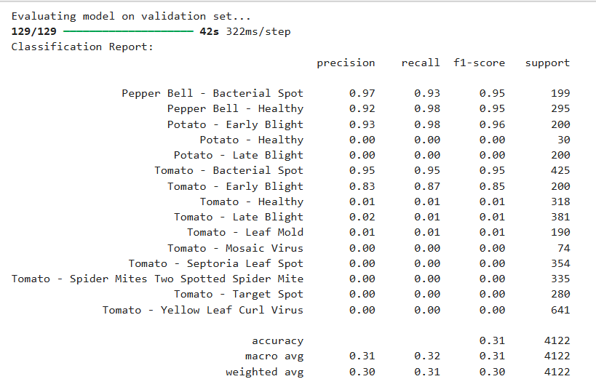
Output
Evaluating validation set

Slide 9
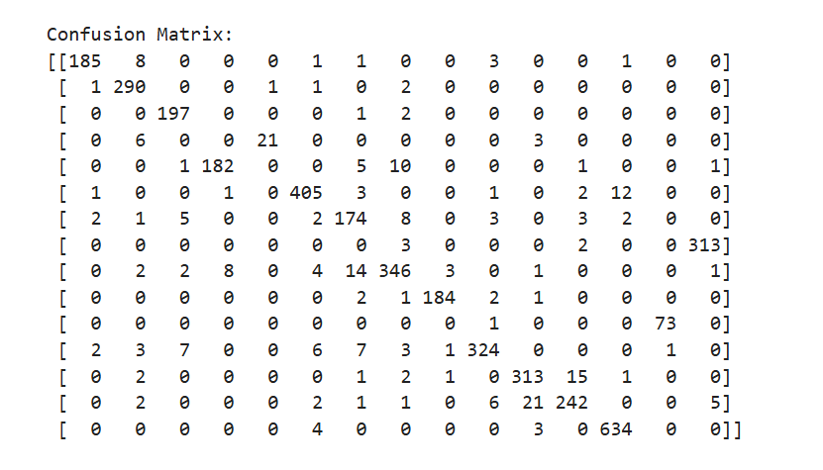
Output
Confusion matrix

Slide 10
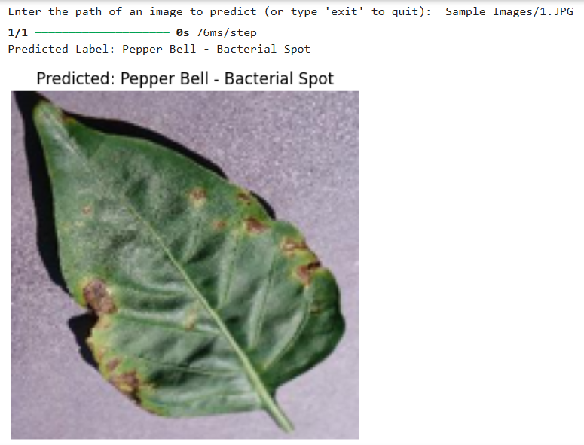
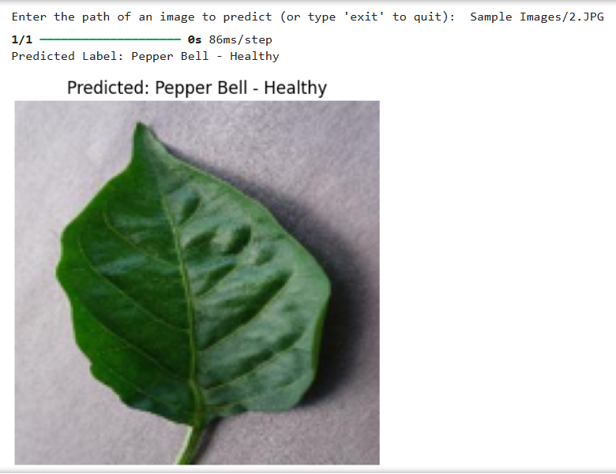
Output
Model showing input image with its predicted leaf disease

Slide 11
Conclusion
The emergence of plant pathogens poses a significant threat to global food security, ecosystems, and economies. Factors such as globalization, increased mobility, vectors, climate change, and pathogen evolution have accelerated the spread of invasive plant pathogens. To address agricultural losses, the development of automated approaches for plant disease detection and classification is urgently needed. This review explores the use of machine learning (ML), deep learning (DL), and few-shot learning (FSL) for automated plant disease recognition. It highlights key methodologies, including acquisition, preprocessing, segmentation, feature extraction, and classification.

Slide 12
Future Scope
Model Optimization and Tuning: Further improvements can be made by experimenting with advanced architectures, such as transfer learning using pre-trained models like VGG or ResNet, which may boost accuracy and reduce training time.
Dataset Expansion: Adding more leaf images for each species would improve the model's robustness and generalization.
Real-time Deployment: The model could be integrated into a mobile or web application for real-time flower recognition in the field.
Multi-label Classification: Extend the model to identify multiple attributes

Slide 13
References
[19] K. Bashir, M. Rehman, and M. Bari, "Detection and classification of rice diseases: An automated approach using textural features," Mehran Univ. Res. J. Eng. Technol., vol. 38, no. 1, pp. 239–250, Jan. 2019.
[20] J. Parraga-Alava, K. Cusme, A. Loor, and E. Santander, "RoCoLe: A robusta coffee leaf images dataset for evaluation of machine learning-based methods in plant diseases recognition," Data Brief, vol. 25, Aug. 2019, Art. no. 104414, doi: 10.1016/j.dib.2019.104414.
[21] A. N. I. Masazhar and M. M. Kamal, "Digital image processing technique for palm oil leaf disease detection using multiclass SVM classifier," in Proc. IEEE 4th Int. Conf. Smart Instrum., Meas. Appl. (ICSIMA), Nov. 2017, pp. 1–6.
[22]S. Kaur, S. Pandey, and S. Goel, ‘‘Semi-automatic leaf disease detection and classification system for soybean culture,’’ IET Image Process., vol. 12, no. 6, pp. 1038–1048, Jun. 2018
[23]P. Goncharov, G. Ososkov, A. Nechaevskiy, A. Uzhinskiy, andI. Nestsiarenia, ‘‘Disease detection on the plant leaves by deep learning,’’ in Advances in Neural Computation, Machine Learning, and Cognitive Research II. Cham, Switzerland: Springer, 2019, pp. 151–159.
[24]M. Francisco, F. Ribeiro, J. Metrôlho, and R. Dionísio, ‘‘Algorithms and models for automatic detection and classification of diseases and pests in agricultural crops: A systematic review,’’ Appl. Sci., vol. 13, no. 8, p. 4720, Apr. 2023.
[25] M. Bhagat and D. Kumar, "Efficient feature selection using BoWs and SURF method for leaf disease identification," Multimedia Tools and Applications, vol. 82, no. 18, pp. 28187–28211, Feb. 2023, doi: 10.1007/s11042-023-14625-5.
[26] A. S. Deshapande, S. G. Giraddi, K. G. Karibasappa, and S. D. Desai, "Fungal disease detection in maize leaves using Haar wavelet features," in Information and Communication Technology for Intelligent Systems. Singapore: Springer, 2019, pp. 275–286.
[27] S. S. Chouhan, U. P. Singh, and S. Jain, "Applications of computer vision in plant pathology: A survey," Archives of Computational Methods in Engineering, vol. 27, no. 2, pp. 611–632, Apr. 2020.

Slide 14
References
[28]S. M. Kiran and D. N. Chandrappa, ‘‘Plant disease identification using discrete wavelet transforms and SVM,’’ J. Univ. Shanghai Sci. Technol., vol. 23, no. 6, pp. 108–114, 2021. [Online]. Available: https://jusst. org/wp-content/uploads/2021/06/Plant-Disease-Identification-Using-Discrete-Wavelet-Transforms-and-SVM-1.pdf
[29]R. R. Patil and S. Kumar, ‘‘Rice-fusion: A multimodality data fusion framework for rice disease diagnosis,’’ IEEE Access, vol. 10, pp. 5207–5222, 2022.
[30]D. Zhang, X. Zhou, J. Zhang, Y. Lan, C. Xu, and D. Liang, ‘‘Detection of rice sheath blight using an unmanned aerial system with high-resolution color and multispectral imaging,’’ PLoS ONE, vol. 13, no. 5, May 2018, Art. no. e0187470.
[31]V. K. Shrivastava and M. K. Pradhan, ‘‘Rice plant disease classifi- cation using color features: A machine learning paradigm,’’ J. Plant Pathol., vol. 103, no. 1, pp. 17–26, Oct. 2020, doi: 10.1007/s42161-020- 00683-3.
[32]A. K. Rath and J. K. Meher, ‘‘Disease detection in infected plant leaf by computational method,’’ Arch. Phytopathol. Plant Protection, vol. 52, nos. 19–20, pp. 1348–1358, Dec. 2019.
[33] M. Azadbakht, D. Ashourloo, H. Aghighi, S. Radiom, and A. Alimohammadi, "Wheat leaf rust detection at canopy scale under different LAI levels using machine learning techniques," Comput. Electron. Agricult., vol. 156, pp. 119–128, Jan. 2019.
[34]B. S. Kusumo, A. Heryana, O. Mahendra, and H. F. Pardede, ‘‘Machine learning-based for automatic detection of corn-plant diseases using image processing,’’ in Proc. Int. Conf. Comput., Control, Informat. Appl. (IC3INA), Nov. 2018, pp. 93–97.
[35]A. Kaya, A. S. Keceli, C. Catal, H. Y. Yalic, H. Temucin, andB. Tekinerdogan, ‘‘Analysis of transfer learning for deep neural network based plant classification models,’’ Comput. Electron. Agricult., vol. 158, pp. 20–29, Mar. 2019.
[36]L. Hallau, M. Neumann, B. Klatt, B. Kleinhenz, T. Klein, C. Kuhn,M. Röhrig, C. Bauckhage, K. Kersting, A. Mahlein, U. Steiner, andE. Oerke, ‘‘Automated identification of sugar beet diseases using smart- phones,’’ Plant Pathol., vol. 67, no. 2, pp. 399–410, Feb. 2018.

Slide 15
Thank You

